Slide 1
Azure Apps & Infrastructure – SMB Sales Plays
WE SMB Cloud Champion Partner Version
For the latest update please visit your Cloud Champion Portal

Slide 2
PLAY-IN-A-BOX NAVIGATION
Azure Apps & Infrastructure
SMB – PARTNER FACING
Overview
Definitions
PiB Content Overview
Play-in-the-Box
BCDR
WE SMB Cloud Champion Partner Version
PARTNER
Play-in-a-box
Your one-stop shop to land Azure Sales Plays

Slide 3
Solution Areas | Plays | Sales Motions: Definitions
PLAY-IN-A-BOX NAVIGATION
Overview
Definitions
PiB Content Overview
SOLUTION
AREAS
| App & Infra | Data & AI | 2 solution pillars designed to help our customers achieve their Digital Transformation outcomes.
Play-in-the-Box
1
BCDR
SOLUTION SALES PLAYS
A Play is a defined, programmatic approach to monetize a prioritized capability of a solution area.
Example: SAP on Azure is a specific capability of Applications & Infrastructure solution area and a targeted approach to monetize this capability, will be defined through a play.
2
SALES MOTIONS
Targeted set of activities that help operationalize the play by generating demand, accelerating pipe and/or driving consumption for it.
Example: Targeting Upper Midsized Business accounts using Azure Cloud Migration Assessment will be one of the sales motions to land a WS / SQL Server on Azure play.
3
Notes:
Cloud Migration Services: $7B
Azure market: $500B

Slide 4
The 6-point Execution Agenda for Landing the Partner Sales Play-in-a-Box
PLAY-IN-A-BOX NAVIGATION
Overview
Definitions
PiB Content Overview
Play-in-the-Box
BCDR
Value Proposition
Target Scenarios
Incentive/Offer
1
2
3
Sales & Marketing
Assets
Probing Questions
Enablement
4
5
6

Slide 5
Go back to TOC
1. Business Continuity & Disaster Recovery (BCDR)

Slide 6
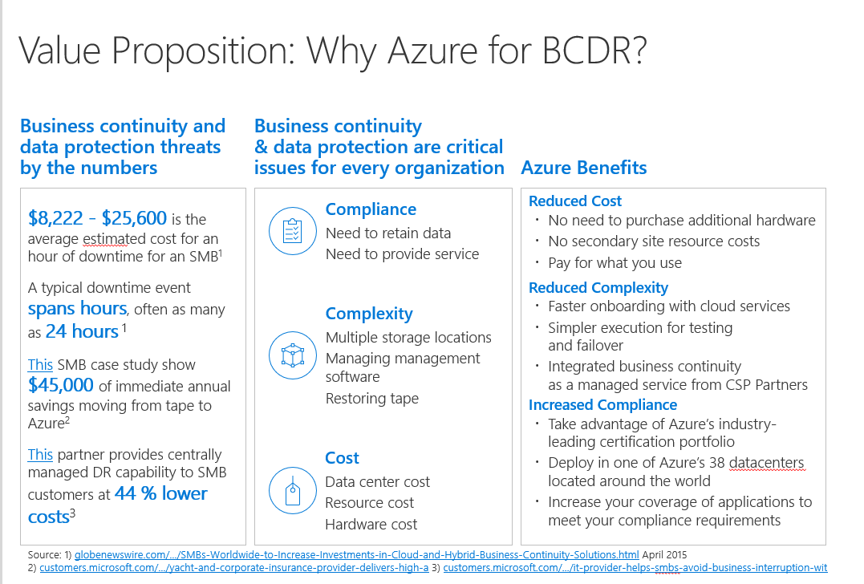
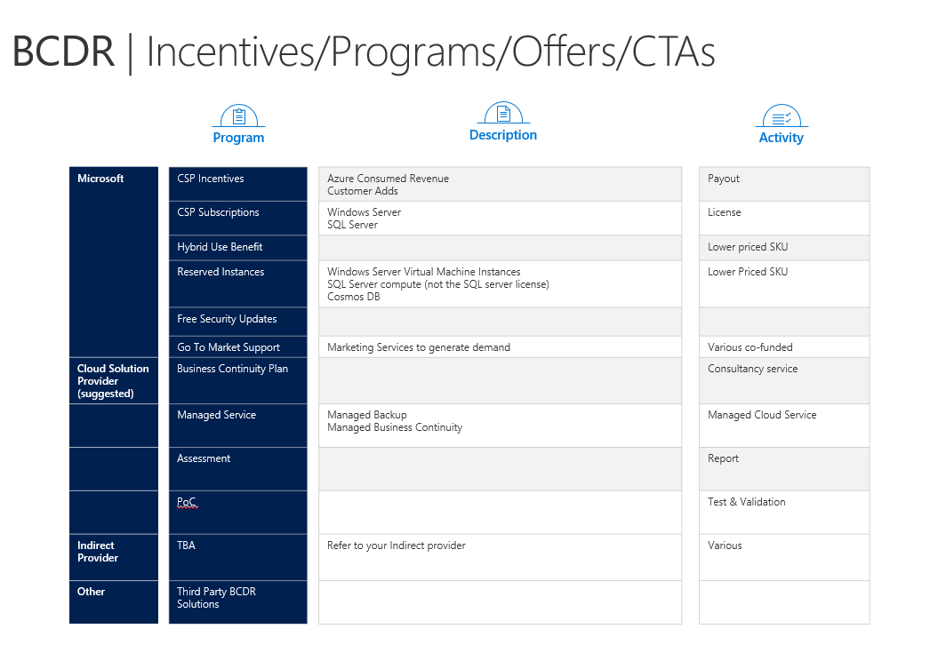
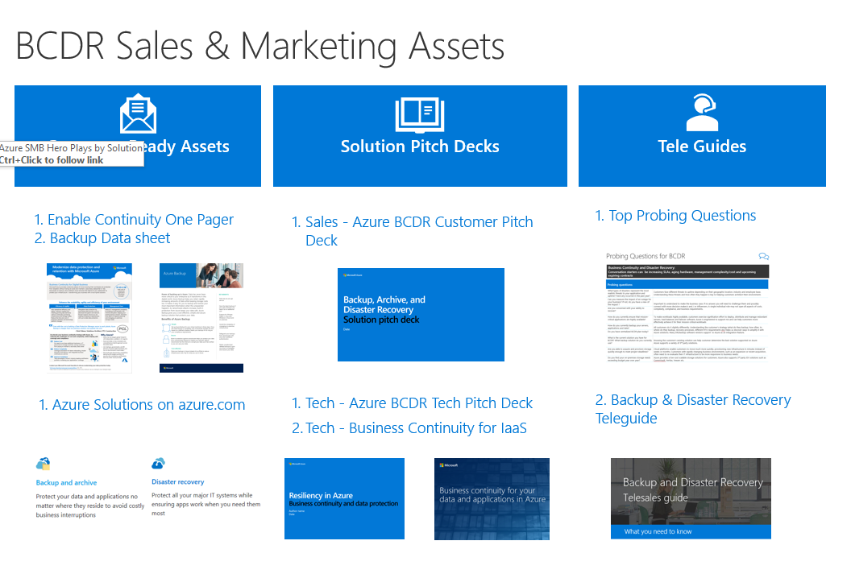
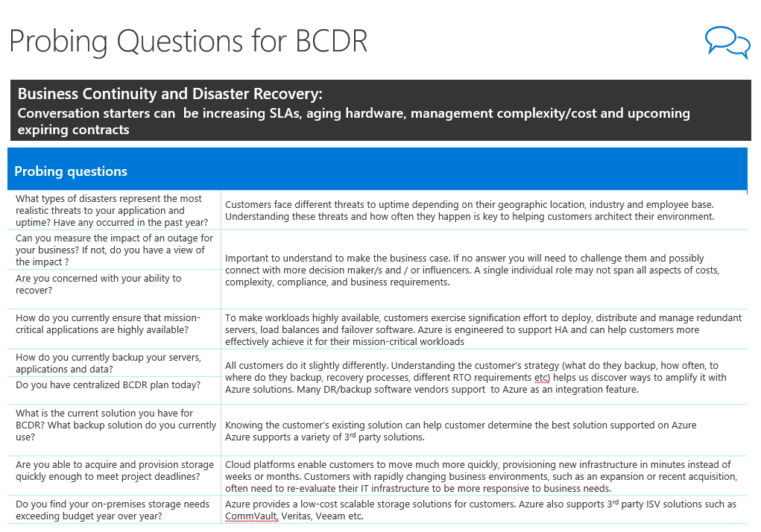
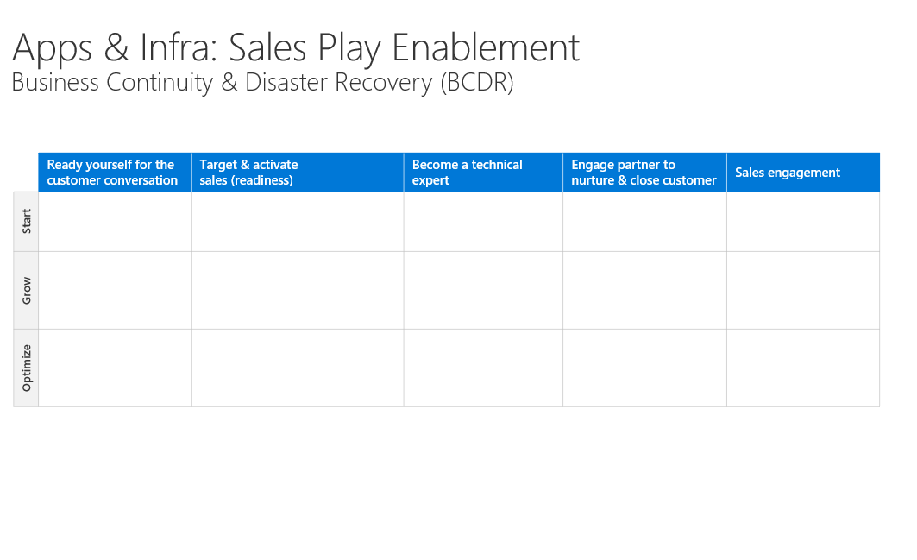
Business Continuity & Disaster Recovery (BCDR) PiB
PLAY-IN-A-BOX NAVIGATION
Overview
Definitions
Building SMB Plays
Play-in-the-Box
Value Proposition
Target Scenarios
Incentives/Offers/CTAs
BCDR
1
2
3
1. Value Proposition
Any customer whom in the past could not afford a BCDR solution matching their real needs
All customers looking to reduce cost and complexity and at the same time improve their BCDR solution to secure and increase uptime
Customers evaluating and/or are in process moving workloads to the cloud should all consider a cloud based BCDR
2. Target Scenarios
3. Incentive/Offer/CTAs
4. Sales & Marketing Assets
5. Probing Questions
6. Enablement
Click on image for more details
Click on image for more details
Sales & Marketing Assets
Probing Questions
Enablement
4
5
6
Click on image for more details
Click on image for more details
Click on image for more details

Slide 7
Value Proposition: Why Azure for BCDR?
PLAY-IN-A-BOX NAVIGATION
Overview
Definitions
Building SMB Plays
Business continuity and data protection threats by the numbers
Business continuity & data protection are critical issues for every organization
Azure Benefits
SMB Plays by Solution
Play-in-the-Box
BCDR
1. Value Proposition
2. Target Scenarios
$8,222 - $25,600 is the average estimated cost for an hour of downtime for an SMB¹
A typical downtime event spans hours, often as many as 24 hours ¹
This SMB case study show $45,000 of immediate annual savings moving from tape to Azure²
This partner provides centrally managed DR capability to SMB customers at 44 % lower costs³
Compliance
Need to retain data
Need to provide service
Reduced Cost
No need to purchase additional hardware
No secondary site resource costs
Pay for what you use
Reduced Complexity
Faster onboarding with cloud services
Simpler execution for testing and failover
Business continuity as a managed service from CSP Partners
Increased Compliance
Take advantage of Azure’s industry-leading certification portfolio
Deploy in one of Azure’s more than 38 datacenters located around the world
Increase your coverage of applications to meet your compliance requirements
3. Incentive/Offer/CTAs
4. Sales & Marketing Assets
5. Probing Questions
6. Enablement
Complexity
Multiple storage locations
Managing management software
Restoring tape
Cost
Data center cost
Resource cost
Hardware cost
Source: 1) globenewswire.com/.../SMBs-Worldwide-to-Increase-Investments-in-Cloud-and-Hybrid-Business-Continuity-Solutions.html April 2015
2) customers.microsoft.com/.../yacht-and-corporate-insurance-provider-delivers-high-a 3) customers.microsoft.com/.../it-provider-helps-smbs-avoid-business-interruption-wit

Slide 8
BCDR | Incentives/Programs/Offers/CTAs
PLAY-IN-A-BOX NAVIGATION
Overview
Definitions
Building SMB Plays
SMB Plays by Solution
Program
Description
Activity
Play-in-the-Box
Microsoft |  | CSP Incentives |  | Azure Consumed Revenue Customer Adds |  | Payout
 |  | CSP Subscriptions |  | Windows Server SQL Server |  | License
 |  | Hybrid Use Benefit |  | Use your license to benefit from a lower price on Windows Server VMs |  | Offer: Lower priced SKU
 |  | Reserved Instances |  | Windows Server Virtual Machine Instances SQL Server compute (not the SQL server license) Cosmos DB |  | Offer: Lower Priced SKU
 |  | Free Security Updates |  |  |  | Offer
 |  | Go To Market Support |  | Marketing Services to generate demand |  | Various co-funded
 |  | WS Hero Offer |  | CSP subscriptions + RI. Link to Partner Center here |  | Offer
 |  | WIP: BCDR Proposal/s |  | WIP: Pre defined proposals for BCDR |  | Predefined proposals
Cloud Solution Provider (suggested) |  | Business Continuity Plan |  | Assist customer in Business Continuity Planning |  | Consultancy service
 |  | Managed Service |  | Managed Backup Managed Business Continuity |  | Packaged Offer/s with monthly fees
 |  | Assessment |  | Cloud migration assessment services – Technical Viability, Business Viability, Migration Planning |  | Report
 |  | PoC |  | Proof of Concept on customer subscription |  | Test & Validation
Indirect Provider |  | TBA |  | Refer to your Indirect provider |  | Various
Other |  | Third Party BCDR Solutions |  | WIP
BCDR
1. Value Proposition
2. Target Scenarios
3. Incentive/Offer/CTAs
4. Sales & Marketing Assets
5. Probing Questions
6. Enablement

Slide 9
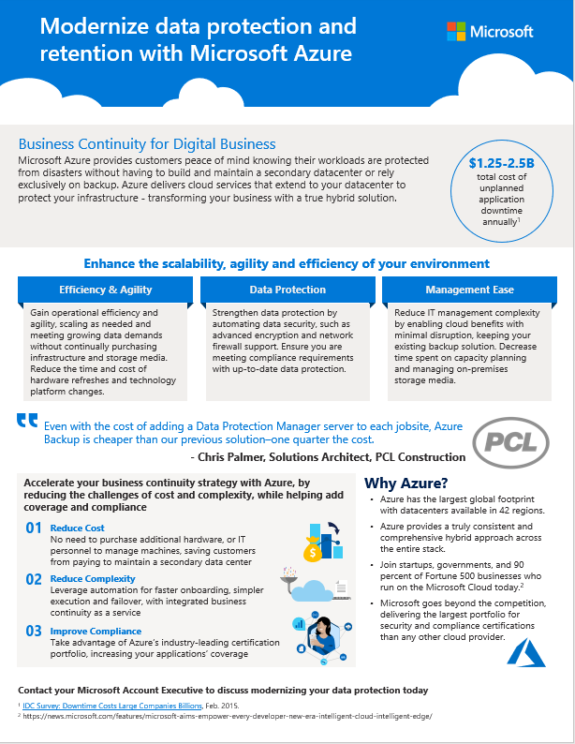
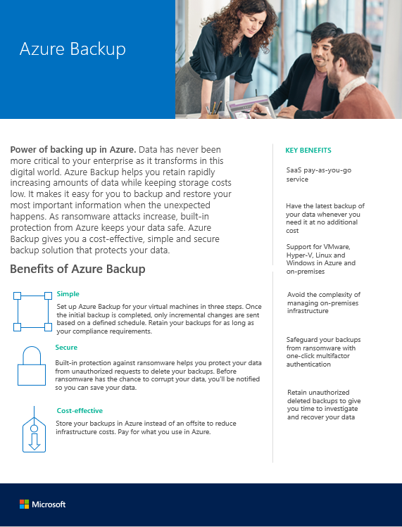
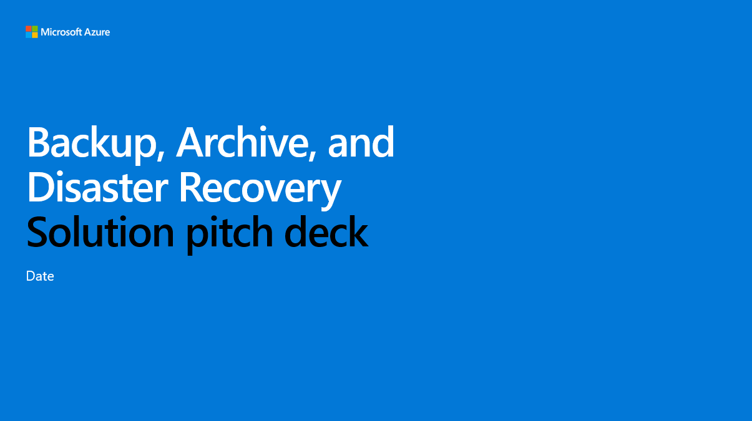
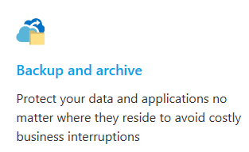
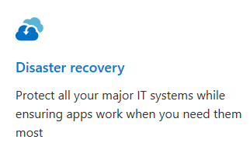
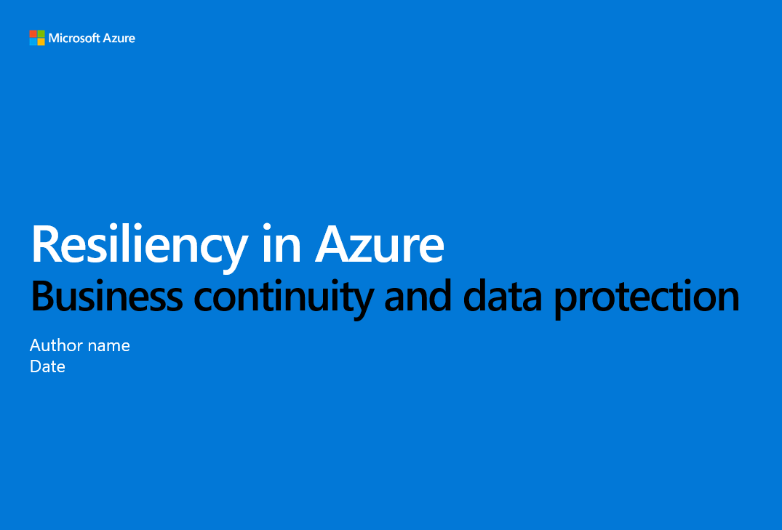
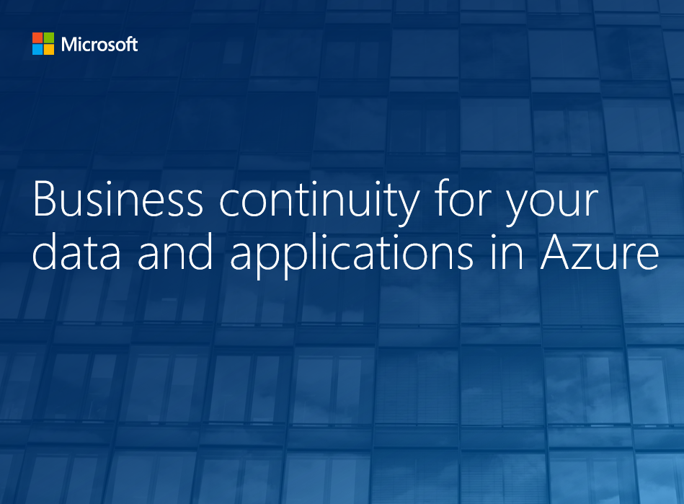
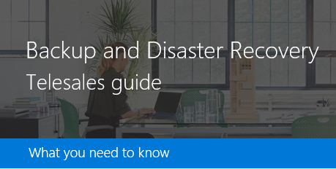
BCDR Sales & Marketing Assets
PLAY-IN-A-BOX NAVIGATION
Overview
Definitions
Building SMB Plays
Customer-Ready Assets
Solution Pitch Decks
Tele Guides
SMB Plays by Solution
Play-in-the-Box
BCDR
1. Value Proposition
2. Target Scenarios
3 Incentive/Offer/CTAs
1. Enable Continuity One Pager
2. Backup Data sheet
Top Probing Questions
4. Sales & Marketing Assets
Sales - Azure BCDR Customer Pitch Deck
5. Probing questions
6. Enablement
1. Azure Solutions on azure.com
Tech - Azure BCDR Tech Pitch Deck
Tech - Business Continuity for IaaS
2. Backup & Disaster Recovery Teleguide

Slide 10
Probing Questions for BCDR 1(2)
PLAY-IN-A-BOX NAVIGATION
Overview
Definitions
Building SMB Plays
Business Continuity and Disaster Recovery:
Conversation starters can be increasing SLAs, aging hardware, management complexity/cost and upcoming expiring contracts
SMB Plays by Solution
Play-in-the-Box
BCDR
Probing questions
1. Value Proposition
2. Target Scenarios
3. Incentive/Offer/CTAs
What types of disasters represent the most realistic threats to your application and uptime? Have any occurred in the past year? | Customers face different threats to uptime depending on their geographic location, industry and employee base. Understanding these threats and how often they happen is key to helping customers architect their environment.
Can you measure the impact of an outage for your business? If not, do you have a view of the impact ? | Important to understand to make the business case. If no answer you will need to challenge them and possibly connect with more decision maker/s and / or influencers. A single individual role may not span all aspects of costs, complexity, compliance, and business requirements.
Are you concerned with your ability to recover?
How do you currently ensure that mission-critical applications are highly available? | To make workloads highly available, customers exercise signification effort to deploy, distribute and manage redundant servers, load balances and failover software. Azure is engineered to support HA and can help customers more effectively achieve it for their mission-critical workloads
How do you currently backup your servers, applications and data? | All customers do it slightly differently. Understanding the customer’s strategy (what do they backup, how often, to where do they backup, recovery processes, different RTO requirements etc) helps us discover ways to amplify it with Azure solutions. Many DR/backup software vendors support to Azure as an integration feature.
Do you have centralized BCDR plan today?
What is the current solution you have for BCDR? What backup solution do you currently use? What challenges do you have ? | Knowing the customer’s existing solution the challenges can help customer determine the best solution supported on Azure. Azure supports a variety of 3rd party solutions should the customer want to keep current vendor.
Are you able to acquire and provision storage quickly enough to meet project deadlines? | Cloud platforms enable customers to move much more quickly, provisioning new infrastructure in minutes instead of weeks or months. Customers with rapidly changing business environments, such as an expansion or recent acquisition, often need to re-evaluate their IT infrastructure to be more responsive to business needs.
Do you find your on-premises storage needs exceeding budget year over year? | Azure provides a low-cost scalable storage solutions for customers. Azure also supports 3rd party ISV solutions such as CommVault, Veritas, Veeam etc.
4. Sales & Marketing Assets
5. Probing Questions
6. Enablement

Slide 11
Objection Handling for BCDR 2 (2)
PLAY-IN-A-BOX NAVIGATION
Overview
Definitions
Building SMB Plays
Business Continuity and Disaster Recovery:
Conversation starters can be increasing SLAs, aging hardware, management complexity/cost and upcoming expiring contracts
SMB Plays by Solution
Play-in-the-Box
BCDR
1. Value Proposition
Objection/question | Suggested Response
“I already have multiple locations for disasterrecovery purposes, why do I need Azure disasterrecovery?” | The cost and complexity of managing multiple locations can be prohibitively expensive. Additionally, as the amount of applications that need protection in your organization grows, so to do the requirements for new infrastructure. With Azure, you get near-infinite scalable service, without the ongoing maintenancerequirements.
“Will Azure disaster recovery work with my existing technology investments?” | You can use Site Recovery to protect most workloads running on a supported VM or physical server. Site Recovery provides support for applicationaware replication, so that apps can be recovered to an intelligent state. It integrates with Microsoft applications such as SharePoint, Exchange, Dynamics, SQL Server (including Always On) and Active Directory, and works closely with leading vendors, including Oracle (Data Guard), SAP, IBMand Red Hat. Learn more about workload protection.
“Can I manage disaster recovery for my branch offices with SiteRecovery?” | Yes. When you use Site Recovery to orchestrate replication and failover in your branch offices, you’ll get a unified orchestration and view of all your branch office workloads in a central location. You can easily run failovers and administer disaster recovery of all branches from your head office, without visiting thebranches.
“For compliance reasons, even our on-premises metadata must remain within the same geographic region. Can Site Recovery helpus?” | Yes. When you create a Site Recovery vault in a region, we ensure that all metadata that we need to enable and orchestrate replication and failover remains within that region’s geographicboundary.
“I want my replicated workloads encrypted. DoesAzure Site Recovery support this?” | For virtual machines and physical servers, encryption-in-transit is supported when replicating between on-premises sites. For virtual machines and physical servers replicating to Azure, both encryption-in-transit and encryption-at-rest (in Azure) aresupported.
“If I replicate to Azure how do I pay for AzureVMs?” | During regular replication, data is replicated to geo-redundant Azure storage and you don’t need to pay any Azure IaaS virtual machine charges, providing a significant advantage. When you run a failover to Azure, Site Recovery automatically creates Azure IaaS virtual machines, and after that you’ll be billed for the compute resources that you consume in Azure, while VMs arerunning.
“What charges do I incur while using Azure Site Recovery?” | While using Azure Site Recovery you incur charges for the Azure Site Recovery license, Azure storage, storage transactions, and outbound data transfer when protecting workloads in Azure. Learn more here.
2. Target Scenarios
3. Incentive/Offer/CTAs
4. Sales & Marketing Assets
5. Probing Questions
6. Enablement

Slide 12
Apps & Infra: Sales Play Enablement – The Essentials Business Continuity & Disaster Recovery (BCDR)
PLAY-IN-A-BOX NAVIGATION
Overview
Definitions
Building SMB Plays
SMB Plays by Solution
Play-in-the-Box
BCDR
 | Ready yourself for the customer conversation | Target & activate your sales | Become a better technical expert
Start | Learn the Backup Datasheet Prepare your probing questions | Use Azure Backup Proactive Proposal Develop and propose pre-packaged offers at a monthly fee | Introduction to Azure Site Recovery & Backup Azure Backup Documentation Learn and use Business Continuity for Applications and Data pitch deck For MPN partners: Backup Guides on MPN
Grow | Learn the BCDR One Pager Learn common objections | Learn BCDR Value proposition Use BCDR Customer Pitch Develop and propose pre-packaged offers at a monthly fee | Site Recovery Documentation Learn and use BCDR tech pitch deck – Resiliency in Azure For MPN Partners: BCDR Guides and demos on MPN For MPN Partners: Hands On Lab
Optimize | Familiarize yourself with 3rd party marketplace offers | Learn 3rd party BCDR Value proposition Co Sell with 3rd party | 1. WIP
1. Value Proposition
2. Target Scenarios
3. Incentive/Offer/CTAs
4. Sales & Marketing Assets
5. Probing questions
6. Enablement

